Slide 1
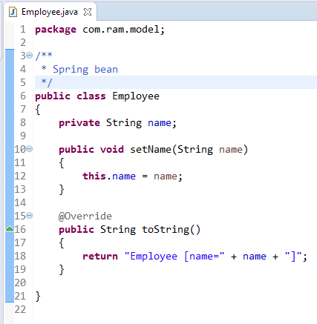
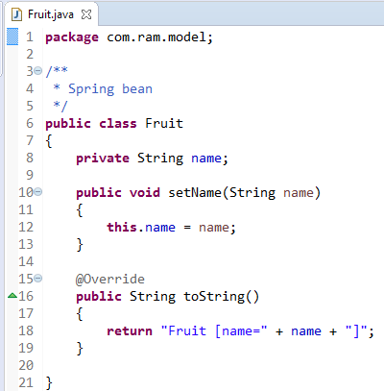
Spring bean life cycle methods – BeanPostProcessor

Slide 2
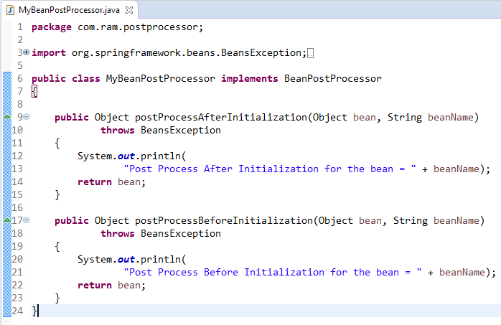
Spring bean life cycle methods – BeanPostProcessor
BeanPostProcessor is used to perform some operations before and after creating a bean, this allows us to add some code before and after creating the bean.
BeanPostProcessor is applicable for all the beans, which means its methods will be executed for each bean we define in the xml.
BeanPostProcessor interface has 2 methods postProcessBeforeInitialization() andpostProcessAfterInitialization() where former is called after the bean is created and before it is initialized And the latter is called after the bean initialization

Slide 3
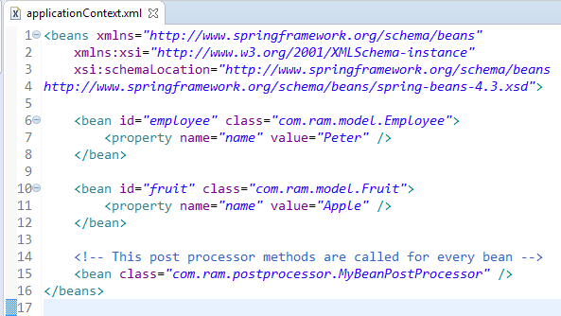
Spring bean life cycle methods – BeanPostProcessor

Slide 4
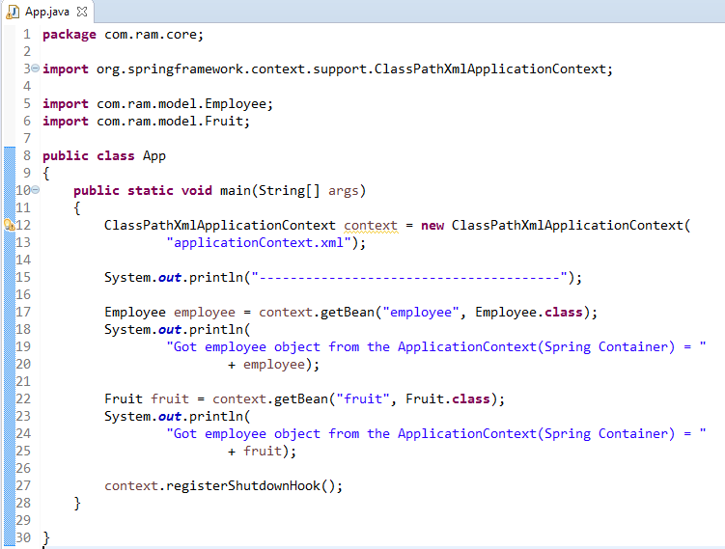
Spring bean life cycle methods – BeanPostProcessor

Slide 5
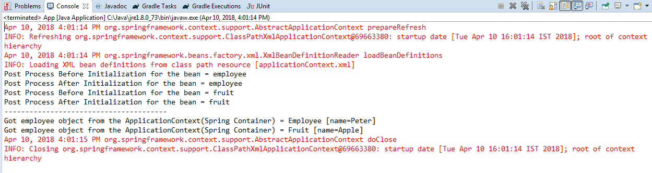
Spring bean life cycle methods – BeanPostProcessor
See the output, BeanPostProcessor’s methods are called for both the beans Employee and Fruit.

